Slide 1

R³
^{(Reduce, Reuse, Recycle)}
Technical Presentation
School: Patapsco Middle School
Grade: Middle School (6th)
State: Maryland
Designed by: The RoboKnights Team
2017-2018
Team Members:
Harini Devireddy
Pragna Yalamanchili
Srinidhi Akella
Venya Karri

Slide 2

Project Objective
Core Objective : Develop a device to efficiently identify recyclable items to reduce landfill Recyclables and minimize environment pollution.
Problem statement : Currently lot of recyclable items are being thrown into the trash and being sent to landfills everyday, this creates toxic chemicals that heat up the earth and contributes to global warming.Another issue with recyclable items in landfills is that they don’t biodegrade quickly. In fact, it takes an average plastic water bottle 500 years to completely biodegrade.

Slide 3
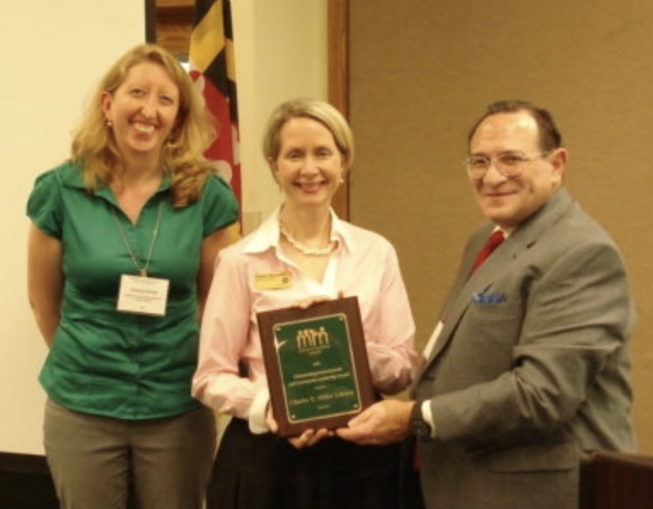
About Our Client
Gemma Evans
Experience:
Planning Specialist
Recycling Coordinator
Assistant Manager
Schoolyard Habits Intern
Assistant Director of Special Events
Education: Warren Wilson College
Honors/Awards: Employee of The Year for October 2010
Accepting the award is Branch Manager, Susan Stonesifer (Middle).
Presented by MRN Vice President Gemma Evans and MRN Awards Chair, Bob Stumpf.

Slide 4

Client Requirements
Client needs:
Need a tool to identify recyclable items and restrict recyclable items to be intermixed with the trash
Efficient Proximity sensing of recyclable items
Needs to be weatherproof and avoid damage from trash inside the container
Needs to have display panel for friendly usability and buzzer prompting
Scope is limited for home usage - Needs further improvements for commercial usage
Constraints:
The object the should not be more than 8mm away from the proximity sensor on the device
Trash should not be filled over the device, which is attached inside the trash bin
The user has to check the power supply (batteries) on a regular basis.

Slide 5
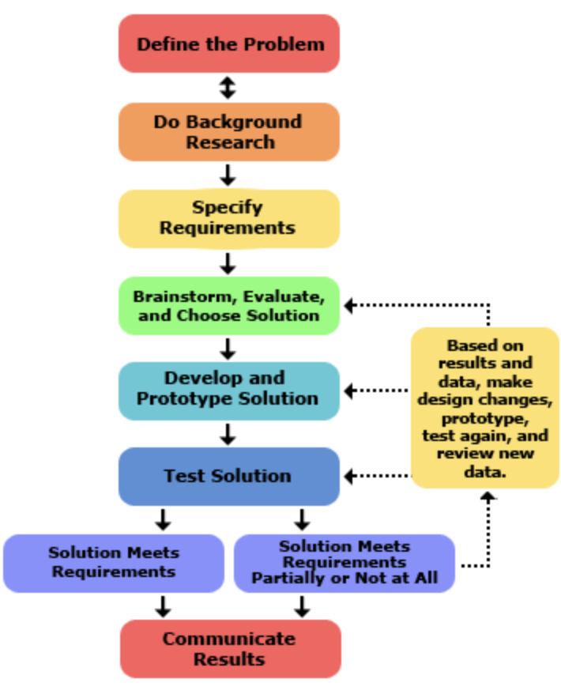
Engineering Design Process
We followed standard engineering design process as our methodology with steps that includes
ASK → IMAGINE → PLAN → CREATE → IMPROVE → SHARE solution
Engineering standard: 3-5-ETS1-2 ; 3-5-ETS1-3
Program Coding standards for arduino e.g.naming convention, single line comments etc.
We did some background research if there any products in market that can efficiently identify recyclable items to avoid intermixing trash, to minimize recyclable items in landfills, and reduce generation of toxic chemicals
We did some brainstorming and came up with 3 different solutions and decided on one final solution
The selected solution for device design has been split into 3 different modules- metal detector, motion detector, and Display Panel
We first built and tested the 3 modules separately then integrated them and tested the integrated device
We had a couple of bugs along the way with both the separate modules and the integrated device which we persevered to fix then test again

Slide 6
Major challenges and correlating
solutions
Currently there is no single device in the market that can efficiently identify all recyclable items from trash and user friendly.
We considered the following solution choices for protype and selected option 3
Option 1: A device to identify recyclable items thrown into (free flow) the trash bin without lid
Option 2: A device to identify recyclable items from the settled items of the trash bin
Option 3: A device to identify trash and recyclable items thrown into the trash bin with lid
But after our brainstorm discussions, we found it is practically difficult to identify settled recyclable items from trash bin and also for free flow items without lid. So finally we chose option 1 as viable solution.
We considered the following capabilities for this iteration but it has foundational framework that can be extendable
Identification of few selected recyclable items - metal detection scope only, individual loading of the items in trash bin, LCD display for prompts along with buzzer, Lid auto open/close, residential usage only.

Slide 7
Modules Implementation
Design and development work has been split into 3 modules:
1. Metal Detector : Metal Detector is the inductive proximity sensor for detecting the metal items. Metal detector module upon identification of metal sends signals in a serial fashion to the code deployed on the arduino board and LCD.
2. Motion and RTC/Temperature Senor : Motion Detector is an Ultrasonic sensor to detect the motion of objects within proximity of 5cm to 15cm and sends serial signals to the arduino board that is programmed to open /close the lid. This also uses Temperature sensor and Real Time Clock (RTC)
3. Display Panel : Based on signals received from metal detector module Liquid Crystal Display (LCD) panel displays “Please Recycle!” prompts, if metal is detected and produces buzzing sound.
Notes:
Change temp sensor to RTC

Slide 8
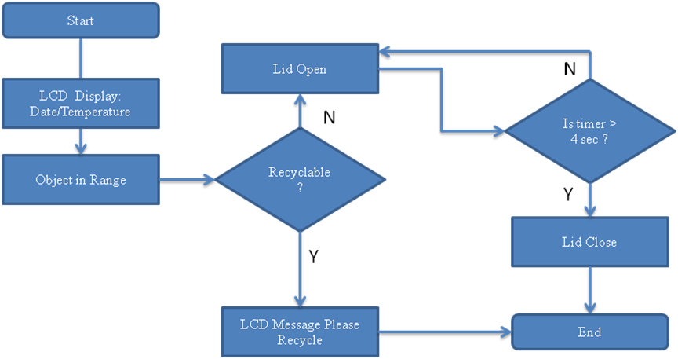
R³ Flow Diagram

Slide 9
Materials Needed
Materials Finalized:
1 Arduino Mega ATmega2560 - 1 Battery holder
1 Inductive Proximity Sensor( NPN type) - 1 Trash bin for prototype
1 Ultrasonic Sensor (HC-SR04) - 1 Buzzer
1 Liquid Crystal Display (HC1624 LCD) - 1 DC Servo (55g)
1 Device holding box - 6V (four AA battries)
1 RTC and Temperature Sensor (DS3231) - Miscellaneous

Slide 10
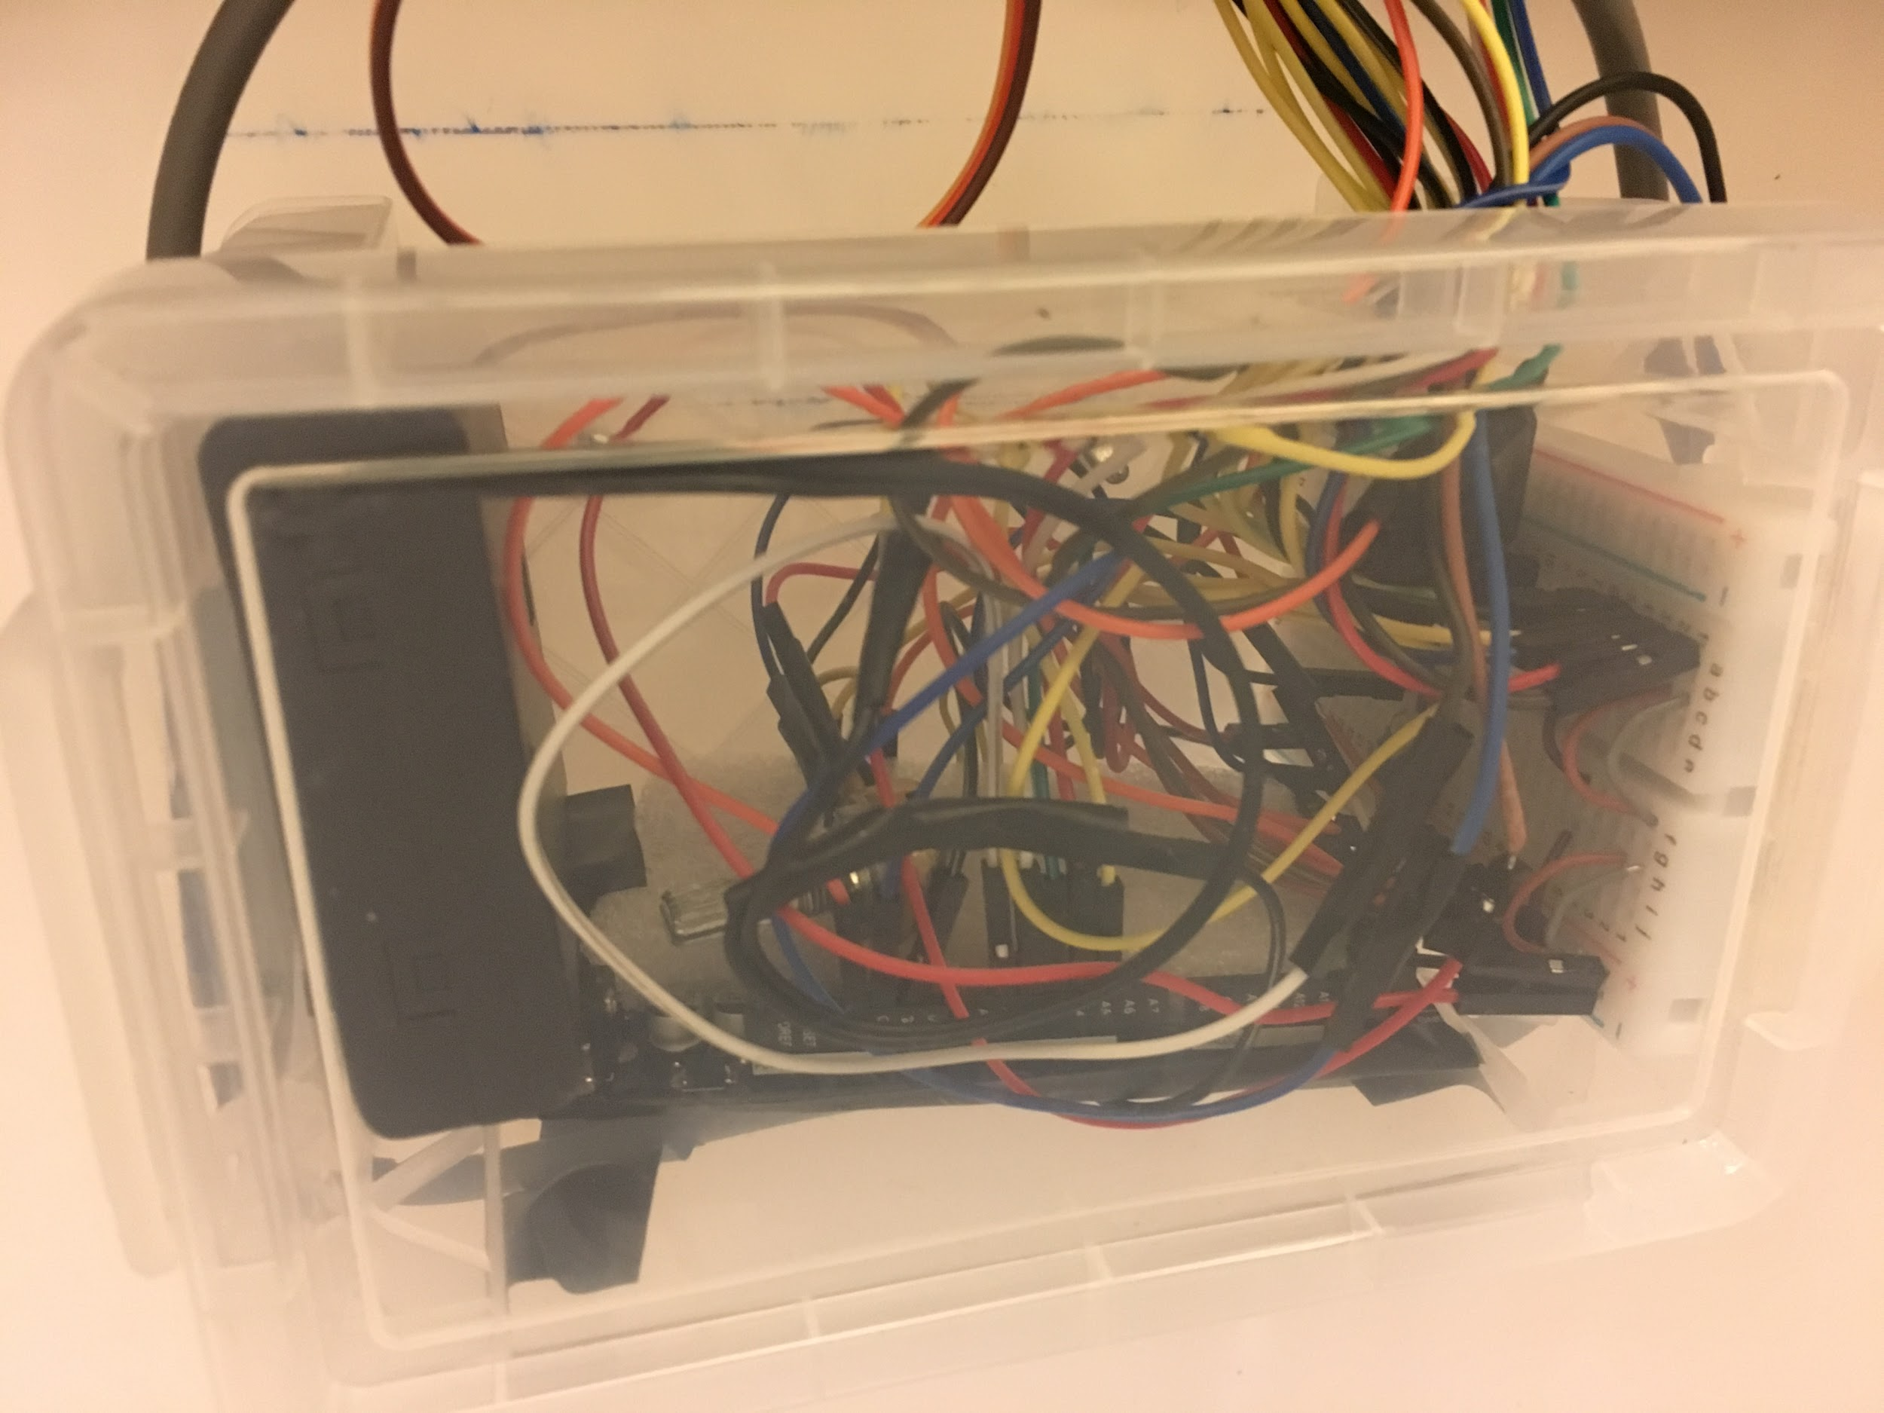
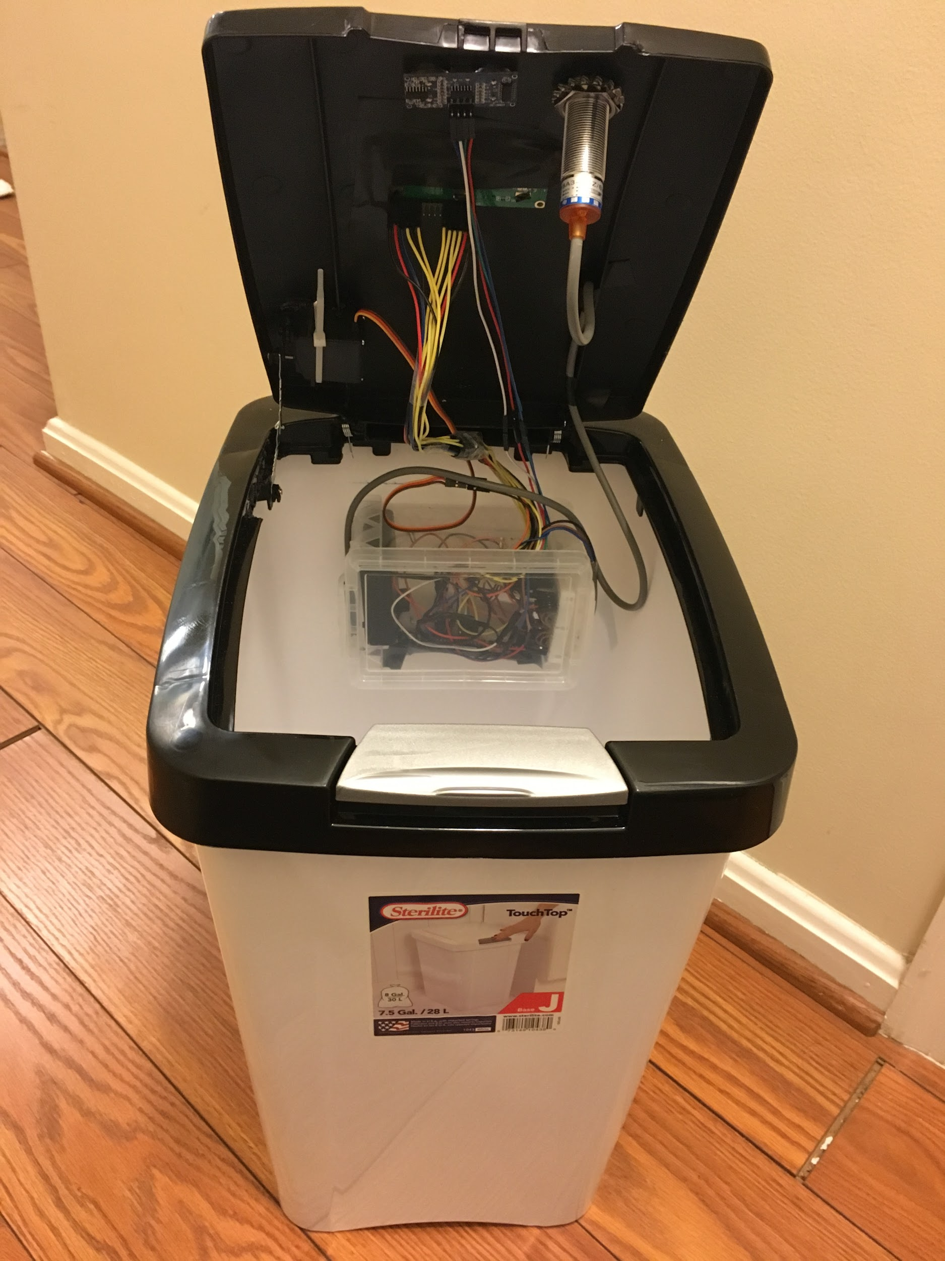
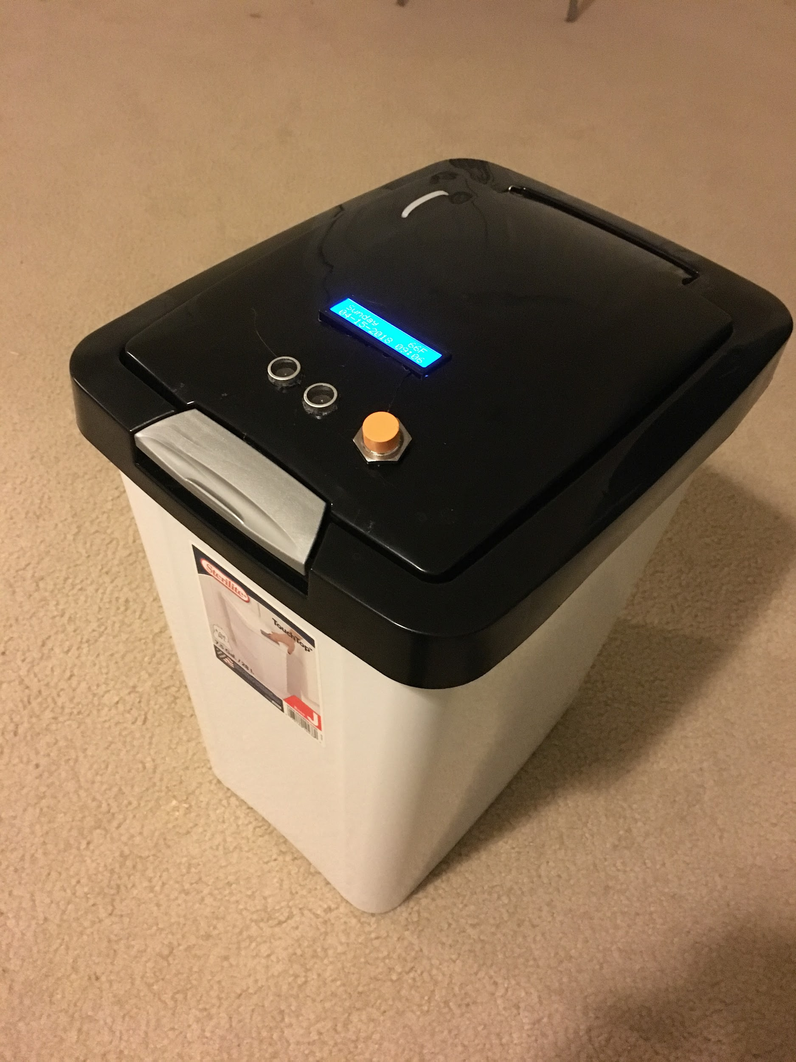
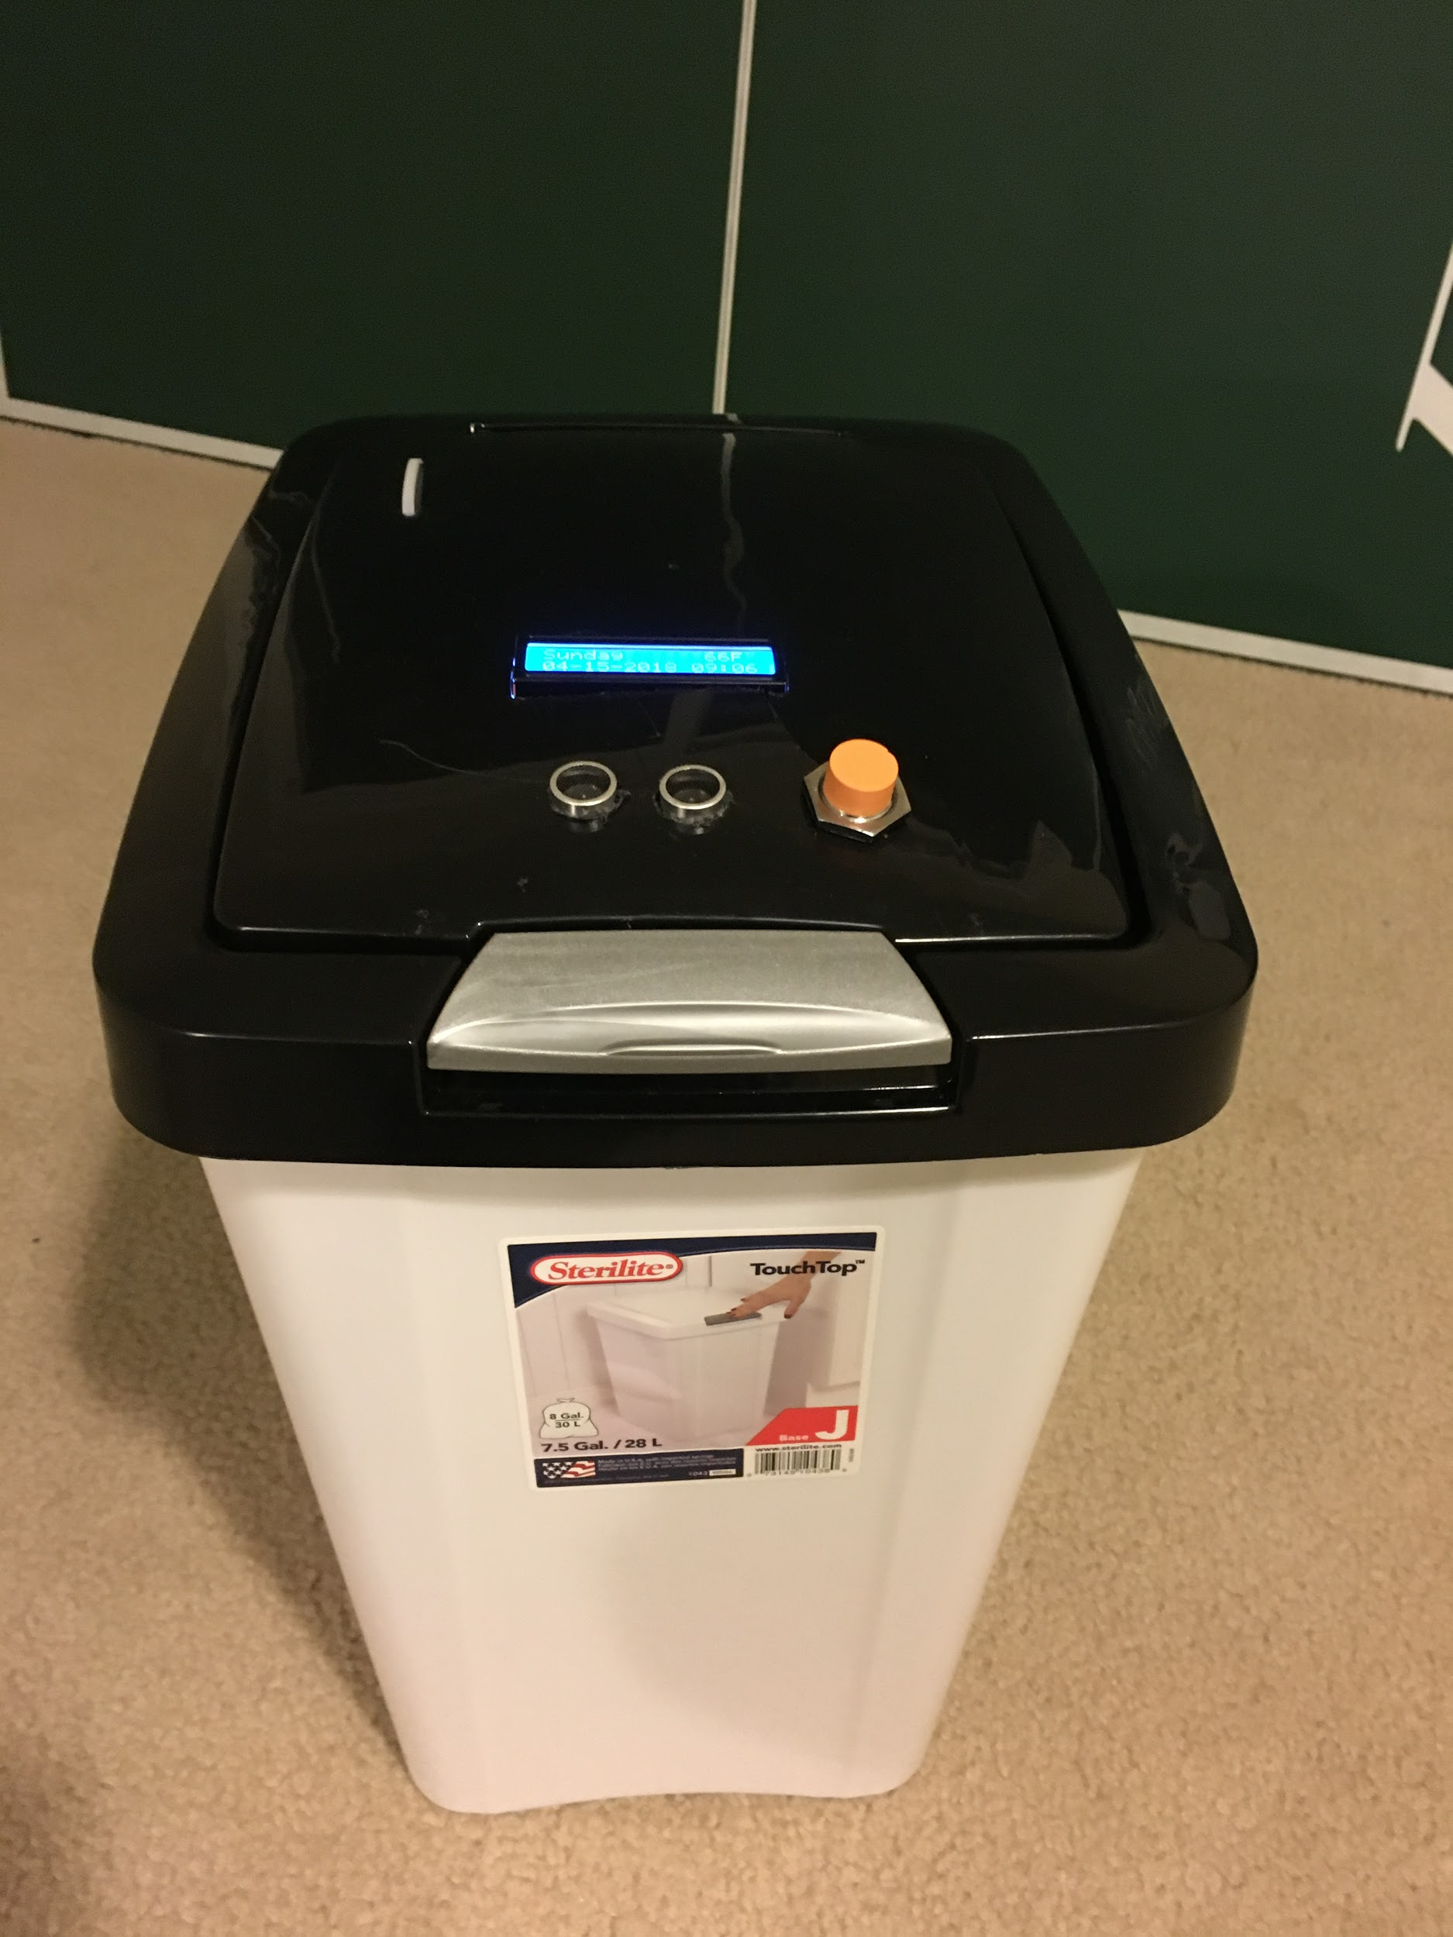
Prototype Demonstration

Slide 11
Testing approach and Results
We have conducted testing for our prototype in two phases:
Unit Testing
Tested each of the modules separately soon after the module code is developed and the corresponding circuit is completed.
Integration Testing
Once all modules are passed unit testing, we integrated code for two Metal Detector module and LCD Panel module with the corresponding integrated circuit and then conducted testing.
Next we integrated Motion Detector module with the already above integrated modules along with the code and the circuit and finally conducted the integrated system testing.
Few of the Test Scenarios are as below:
Placed a metal soda tin in front of the device and the trash lid did not open with the message ‘Please Recycle’ on the LCD display panel.
Placed a non-metal soda tin in front of the device and the trash can lid was opened. No prompting to recycle with the text message on LCD display panel

Slide 12
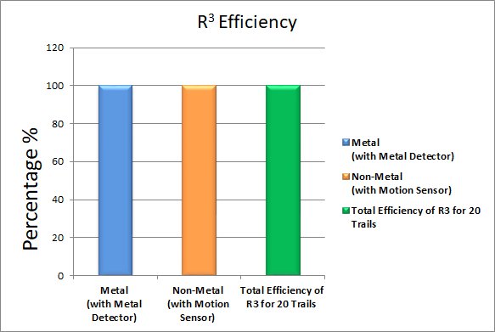
R³ Efficiency

Slide 13
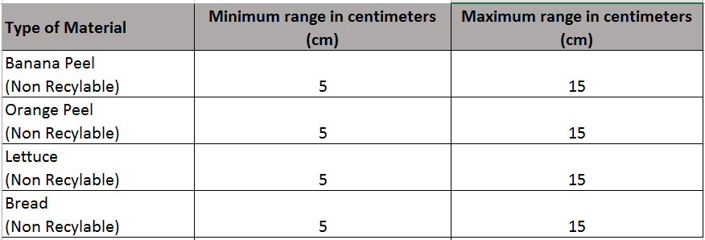
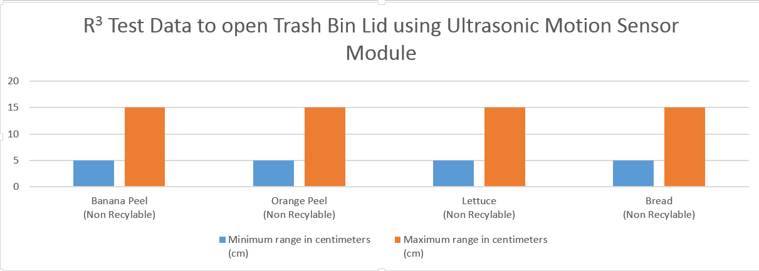
Test Data and Graphs for Non-Metal

Slide 14
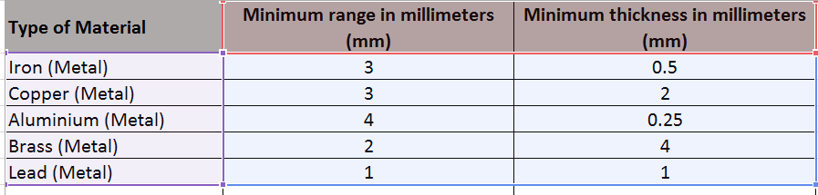
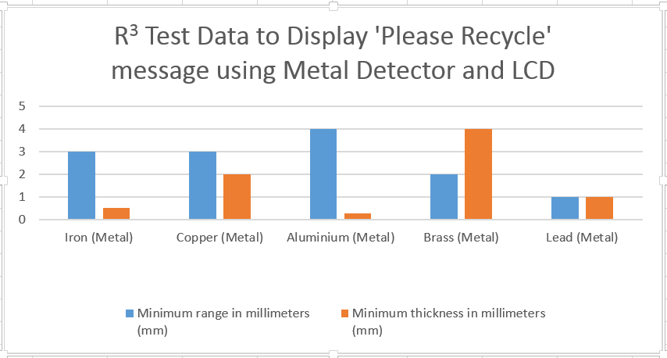
Test Data and Graphs for Metal

Slide 15

Conclusion
The device has foundational framework that can be extendable and currently has following
key features:
Uniqueness of the product to deliver various capabilities like metal detection, LCD display, buzzer prompting and auto lid open/close functionality.
Improves the efficiency of recyclable items identification.
The product has foundational framework with focused capabilities but has potential to be fully extendable to meet broader diversified needs.
Limitations: Metal detection only, individual loading of the items in trash bin, inductive proximity sensor range is low
In summary the device minimizes intermixing of recyclable items with trash in turn helps
Reduction of chemical toxic gases generation from Landfills
Increased Opportunity on recycling and saves energy

Slide 16
Next Steps / Recommendations
Enabling below capabilities are been considered for future enhancements for multi iteration releases for full blown product
Plastic, cardboard, paper and glass detectors are additional capabilities
Monthly repots as notifications to user’s phone with data and reports on how much they have recycled
Extend product capabilities from residential to commercial usage.
Temperature sensor can be used to detect temperature over 80 degrees Fahrenheit inside trash bin, to notify user with a message on LCD - “Please Empty Trash Bin!”
Notes:
Don’t say temp sensor

Slide 17

Any Questions?

